Slide 1
Detection of Diabetes Retinopathy using Support Vector Machine & Random Forest Algorithm
Mentor:
DR. PRIYANKA VASHISHT
Project By:
Akash Rai (00310402715)
Yash Mendiratta (40110402715)
Pragya Yadav (40810402715)
Prashant Goyal (41410402715)

Slide 2
OBJECTIVE
The main objective of the project is to unambiguously define a database and a testing protocol which can be used to benchmark diabetic retinopathy detection methods. By using the database and the defined testing protocol, the results between different methods can be compared.

Slide 3
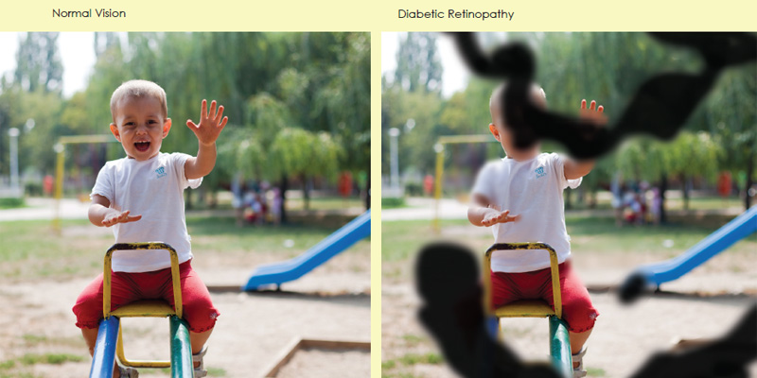
DIABETES RETINOPATHY
Diabetic Retinopathy (DR) is a medical condition of the eye that is caused by diabetes.
It is one of the leading causes for blindness in the working age population.
It's caused by damage to the blood vessels of the light-sensitive tissue at the back of the eye (retina).
Eventually, it can cause blindness.

Slide 4
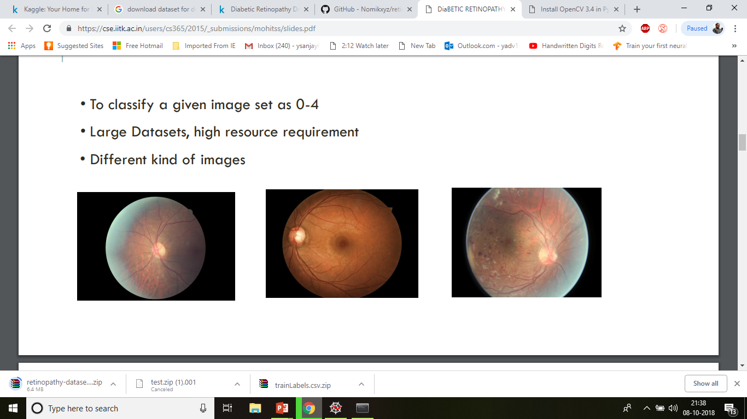
TASKS AND CHALLENGES
TO CLASSIFY A GIVE IMAGE AS NORMAL,MILD , Moderate NPDR OR SERVE NPDR
LARGE DATASETS
HIGH RESOLUTION
DIFFERENT KINDS OF IMAGES

Slide 5
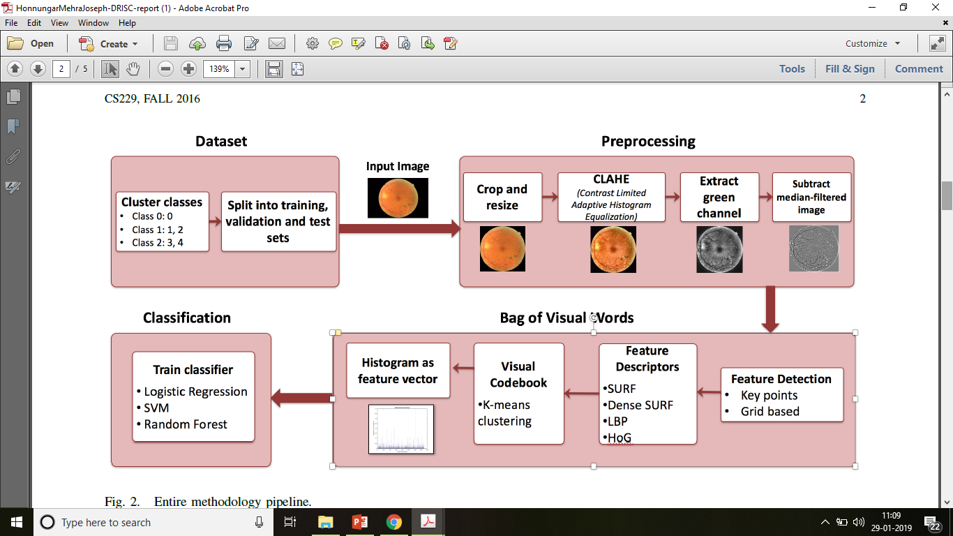
FLOWCHART

Slide 6
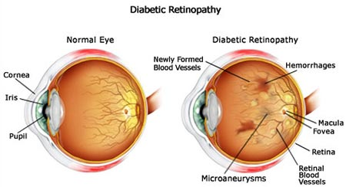
NORMAL EYE VS DIABETIC RETINOPATHY EYE
Fig 1: Normal eye vs Diabetic Retinopathetic eye

Slide 7
SYMPTOMS
PREVENTION
People might not have symptoms in the early stages of diabetic retinopathy. As the condition progresses, diabetic retinopathy symptoms may include: -
Spots or dark strings floating in your vision (floaters)
Blurred vision
Fluctuating vision
Impaired colour vision
Dark or empty areas in your vision
Vision loss
The risk of getting diabetic retinopathy can be reduced significantly by doing the following: -
Managing diabetes
Monitoring blood sugar levels
Keep your blood pressure and cholesterol under control
Quitting smoking and usage of other types of tobacco intake.
Paying attention to vision changes
Asking doctors about a glycosylated haemoglobin test.

Slide 8
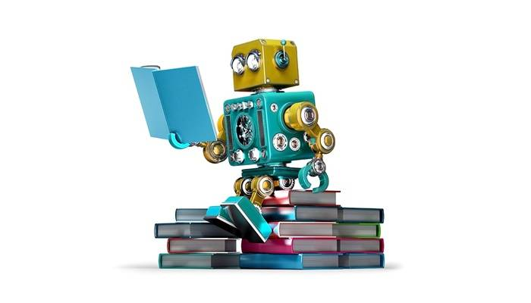
APPROACHES TO THE PROBLEM
DEEP LEARNING
SUPPORT VECTOR MACHINE (SVM)
RANDOM FOREST ALGORITHM

Slide 9


WORK DONE TILL NOW
CONFIGURATIONOF OPEN CV LIBRARY
BASIC IMPLEMENTATION OF OPEN CV
DATA ACQUISITION
CONTRAST ENHANCEMENT USING ADAPTIVE EQUALISATION
CONVERSION INTO GREEN CHANNEL
GREEN CHANNEL TO SUB-MEDIAN FILTER

Slide 10
DATASET
Dataset is generated by Eyepacs and Available at Kaggle.
http://www.kaggle.com/c/diabetic-retinopathy-detection/data
Dataset :
1) consists of 1,000 Images with different shades different camera
2) score by trained professional.

Slide 11
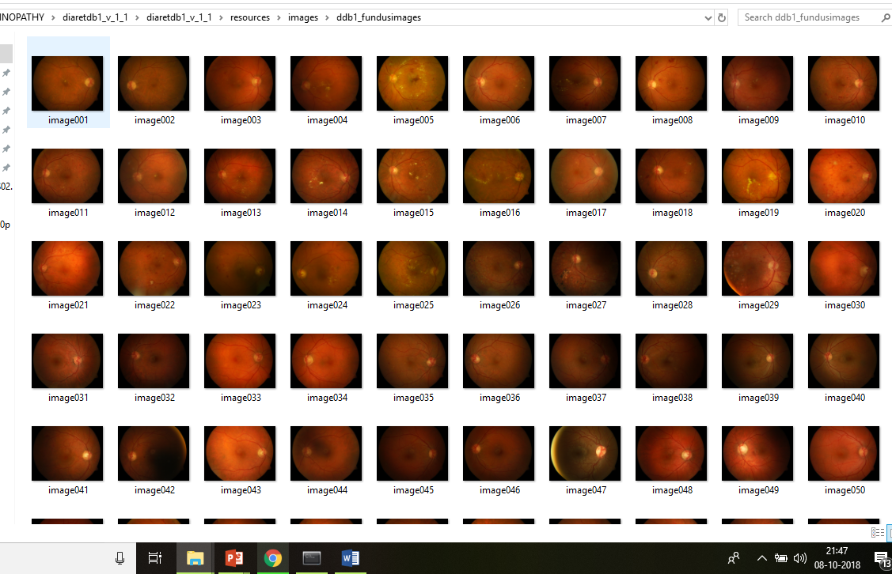

Slide 12
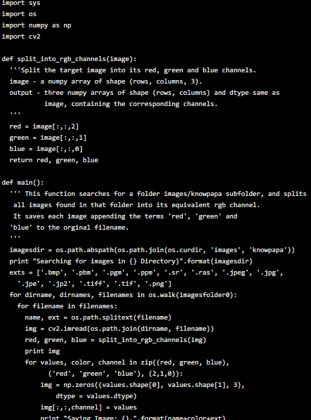
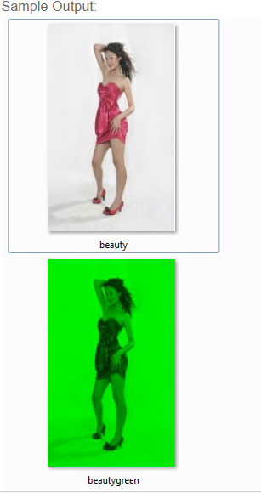

CONVERSION OF IMAGE TO GREEN CHANNEL

Slide 13
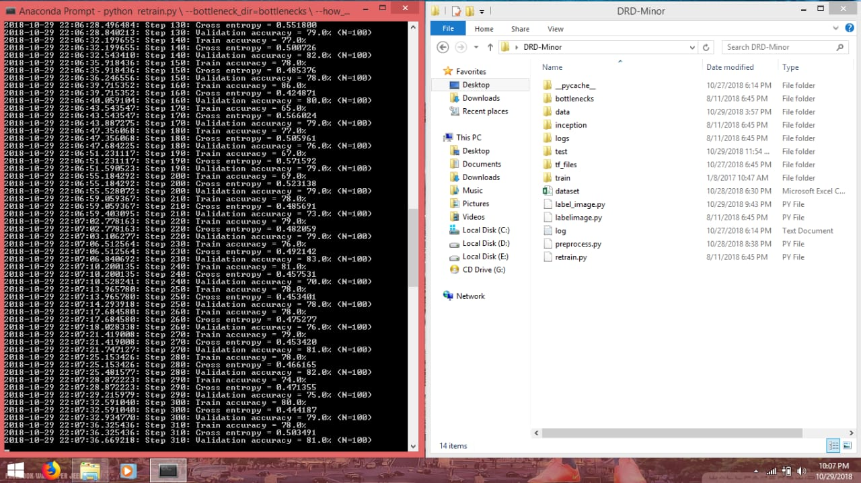
TRAINING

Slide 14
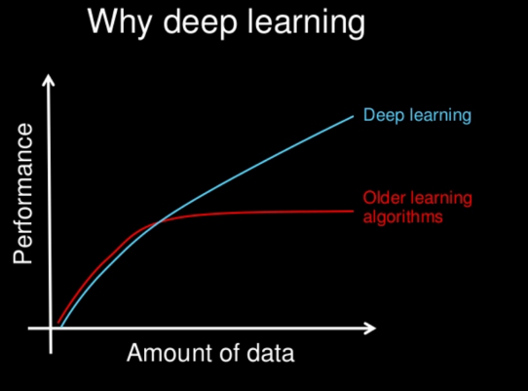
DEEP LEARNING
Deep Learning is a subfield of machine learning concerned with algorithms inspired by the structure and function of the brain called artificial neural networks.

Slide 15
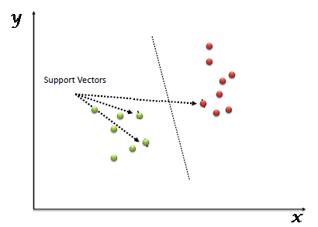
SUPPORT VECTOR MACHINE
A Support Vector Machine (SVM) is a discriminative classifier formally defined by a separating hyperplane. In other words, given labeled training data (supervised learning), the algorithm outputs an optimal hyperplane which categorizes new examples.

Slide 16
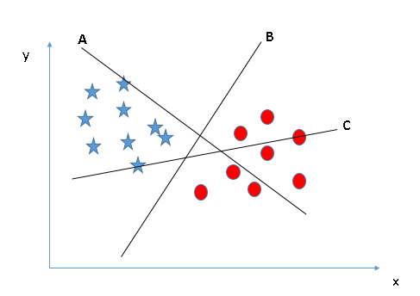
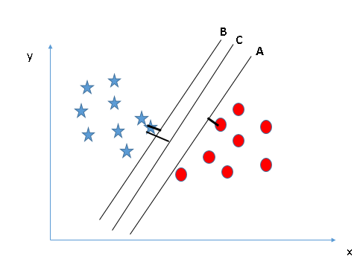
WORKING
Identify the right hyper-plane (Scenario-1): Here, we have three hyper-planes (A, B and C). Now, identify the right hyper-plane to classify star and circle. In this scenario, hyper-plane “B” has excellently performed this job.
Identify the right hyper-plane (Scenario-2): Here, we have three hyper-planes (A, B and C) and all are segregating the classes well. Here, maximizing the distances between nearest data point (either class) and hyper-plane will help us to decide the right hyper-plane. This distance is called as Margin.
As we know that we got accustomed to the process of segregating the two classes with a hyper-plane.

Slide 17
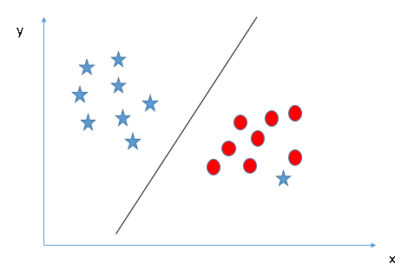
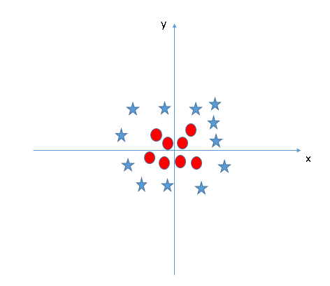
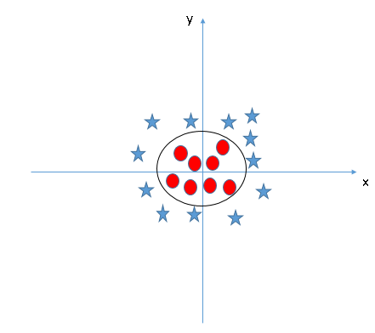
Can we classify two classes (Scenario-3)?: Here, one star at other end is like an outlier for star class. SVM has a feature to ignore outliers and find the hyper-plane that has maximum margin. Hence, we can say, SVM is robust to outliers.
Find the hyper-plane to segregate to classes (Scenario-4): In the scenario below, we can’t have linear hyper-plane between the two classes. Yes, SVM can solve this method by using kernels. i.e. it converts not separable problem to separable problem, these functions are called kernels.

Slide 18
IMPLEMENTATION(SVM)
#Import Library
from sklearn import svm
#Assumed you have, X (predictor) and Y (target) for training data set and x_test(predictor) of test_dataset
# Create SVM classification object model = svm.svc(kernel='linear', c=1, gamma=1)
# there is various option associated with it, like changing kernel, gamma and C value. Will discuss more # about it in next
section.Train the model using the training sets and check score
model.fit(X, y)
model.score(X, y)
#Predict Output predicted= model.predict(x_test).
Kernel: We have already discussed about it. Here, we have various options available with kernel like, “linear”, “rbf”,”poly” and others (default value is “rbf”). Here “rbf” and “poly” are useful for non-linear hyper-plane. Let’s look at the example, where we’ve used linear kernel on two feature of iris data set to classify their class.
Gamma: Kernel coefficient for ‘rbf’, ‘poly’ and ‘sigmoid’. Higher the value of gamma, will try to exact fit the as per training data set i.e. generalization error and cause over-fitting problem.

Slide 19
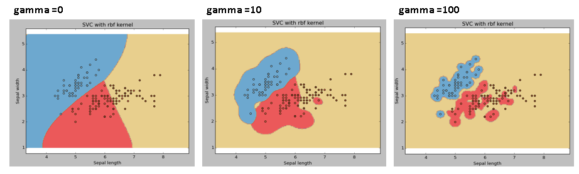
Example: Let’s difference if we have gamma different gamma values like 0, 10 or 100.
svc = svm.SVC(kernel='rbf', C=1,gamma=0).fit(X, y) SVC(kernel='rbf', C=1,gamma=0).fit(X, y) .

Slide 20
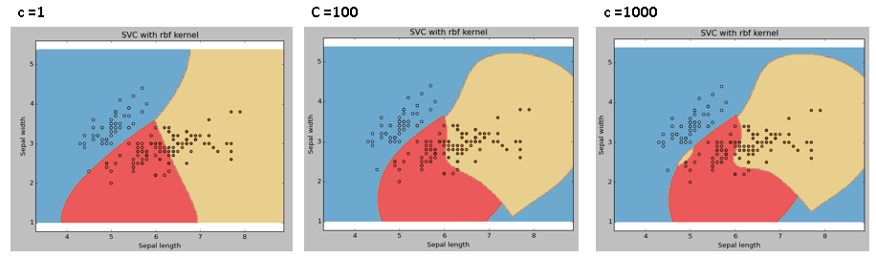
C: Penalty parameter C of the error term. It also controls the trade off between smooth decision boundary and classifying the training points correctly.

Slide 21
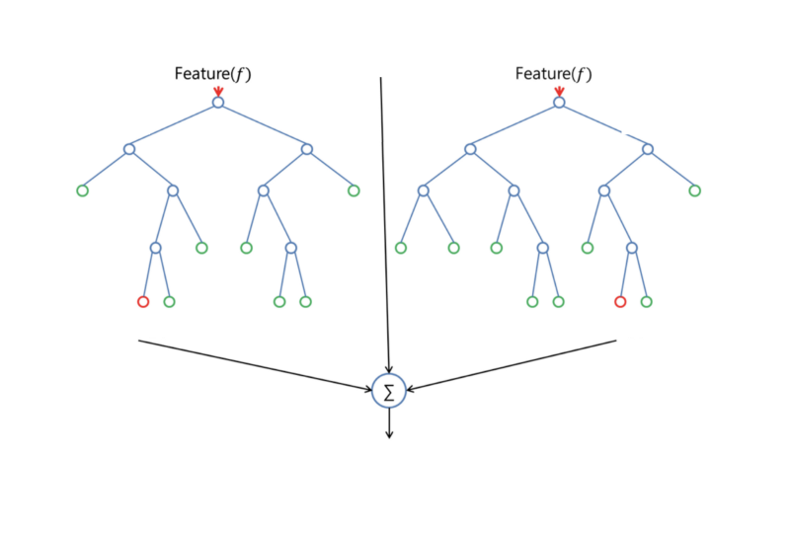
RANDOM FOREST ALGORITHM
Random forest builds multiple decision trees and merges them together to get a more accurate and stable prediction.
One big advantage of random forest is, that it can be used for both classification and regression problems, which form the majority of current machine learning systems. I will talk about random forest in classification, since classification is sometimes considered the building block of machine learning. Below you can see how a random forest would look like with two trees:

Slide 22
LEVELS OF CLASSIFICATION
There are two types of diabetic retinopathy: non-proliferative diabetic retinopathy (NPDR) and proliferative diabetic retinopathy, where the NPDR can be subdivided into mild, moderate and severe .
In fact, NPDR is the most common diabetic retinopathy, representing 80% of all cases.
TYPES OF DIABETIC RETINOPATHY
PROLIFERATIVE(PDR)
NON-PROLIFERATIVE (NPDR)
MILD
MODERATE
SEVERE

Slide 23
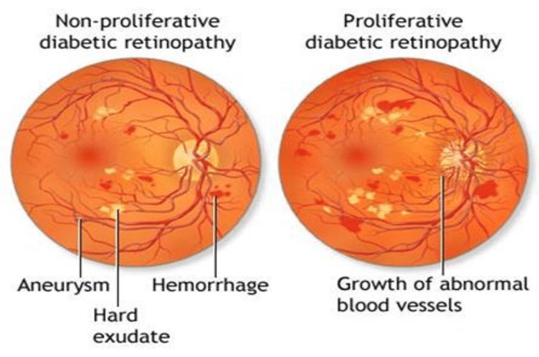
METHODOLOGY
The retinopathy grade diagnoses is normally provided by
medical experts based on:
0. Normal (A=0) and (H=0)
1. Mild NPDR (0<A5) and (H=0)
2. Moderate NPDR (5<A<15 or 0<H<5) and (NV=0)
3. Severe NPDR (A15) or (H5) or (NV=1)
where A is the number of microaneurysms,
H the number of hemorrhages and NV the presence of neovascularization.

Slide 24
REFERENCES
[1] B. Wu, W. Zhu, F. Shi, S. Zhu, and X. Chen, “Automatic detection
of microaneurysms in retinal fundus images,” Computerized Medical
Imaging and Graphics, vol. 55, pp. 106–112, 2017.
[2] R. Maher, S. Kayte, and D. M. Dhopeshwarkar, “Review of automated
detection for diabetes retinopathy using fundus images,” International
Journal of Advanced Research in Computer Science and Software
Engineering, vol. 5, no. 3, pp. 1129–1136, 2015.
[3] D. J. Browning, Diabetic retinopathy: evidence-based management.
Springer Science & Business Media, 2010.
[4] R. Maher, S. Kayte, D. Panchal, P. Sathe, and S. Meldhe, “A decision
support system for automatic screening of non-proliferative diabetic
retinopathy,” International Journal of Emerging Research in Management
and Technology, vol. 4, no. 10, pp. 18–24, 2015.
[5] R. S. Maher, S. N. Kayte, S. T. Meldhe, and M. Dhopeshwarkar,
“Automated diagnosis non-proliferative diabetic retinopathy in fundus
images using support vector machine,” International Journal of Computer
Applications, vol. 125, no. 15, pp. 7–10, 2015.

